Slide 1
IMAGE CLASSIFICATION OF VEGETABLES
DEEP LEARNING CA1 PART A : CONVOLUTIONAL NEURAL NETWORK
Name : Dario Prawara Teh Wei Rong
Class : DAAA / FT / 2B / 04

Slide 2
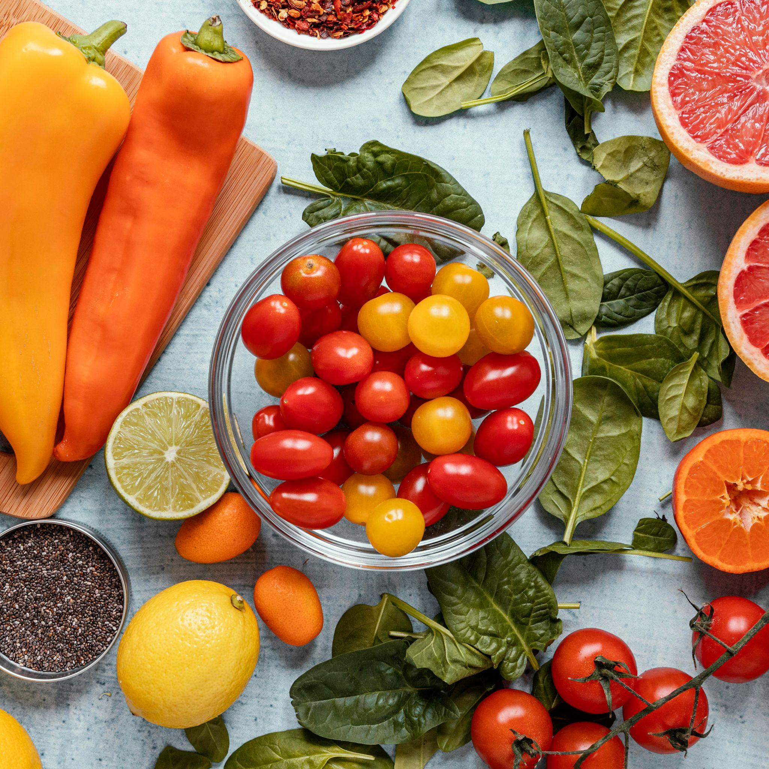
Objective of Analysis
Implement an image classifier using a convolutional neural network for 15 types of vegetables.
Images must be in grayscale format.
Build 2 types of neural networks, one for input size 31 x 31 pixels and one for input size 128 x 128 pixels.
Some images include : Bean ; Bitter Gourd ; Bottle Gourd ; Brinjal etc.

Slide 3
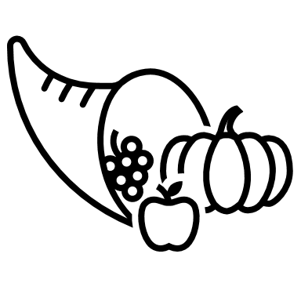
Background Information
CHALLENGES IN VEGETABLE IMAGE CLASSIFICATION
WHY CNN FOR IMAGE CLASSIFICATION?
RECENT ADVANCEMENTS IN IMAGE CLASSIFICATION
Suited for image pattern recognition.
Common architectures include : AlexNet, GoogLeNet, ResNet50.
Many advancements in image classification driven by large datasets like ImageNet.
Training challenges : Overfitting, exploding gradients, class imbalance.
Variability in vegetable appearance may cause classification issues due to its similarity in terms of looks.
Hyperspectral imaging and custom-built CNN does improve accuracy for certain datasets.
Emergence of food computing as a field for deep learning.

Slide 4
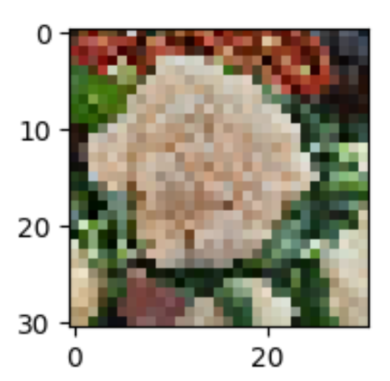
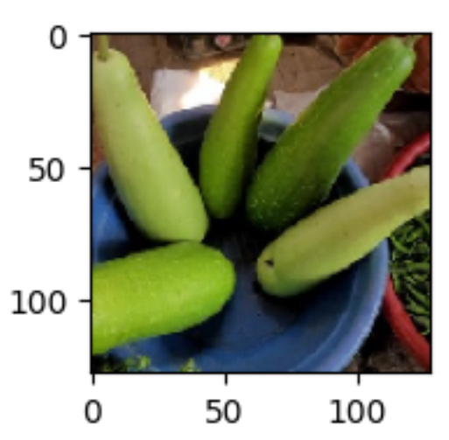
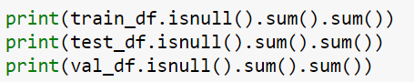
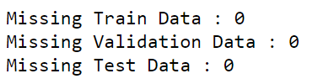
Data Pre-Processing & Analysis
CHECK FOR NULL VALUES
ANALYZE COLORED INPUT IMAGES
Check for null values using isnull().
There are no nulls in any of the image datasets.
31 x 31 px
128 x 128 px
From the 2 images, the 128 x 128 px image is less pixelated and clearer to visualize as it is closer to the actual image size.

Slide 5
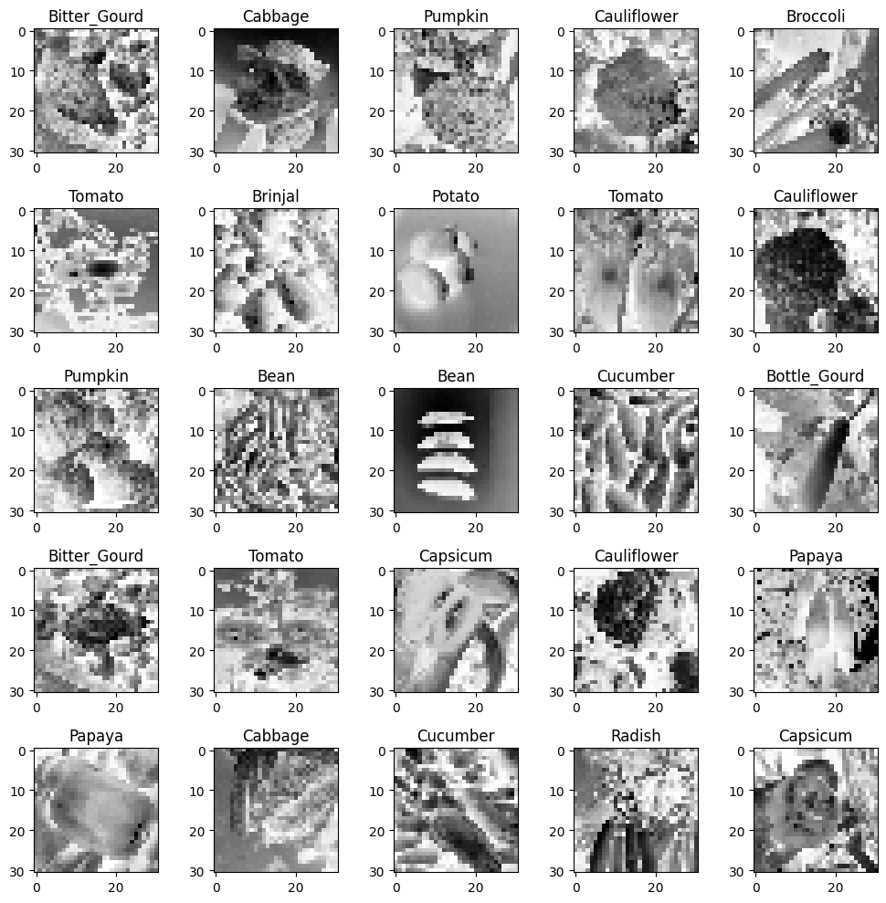
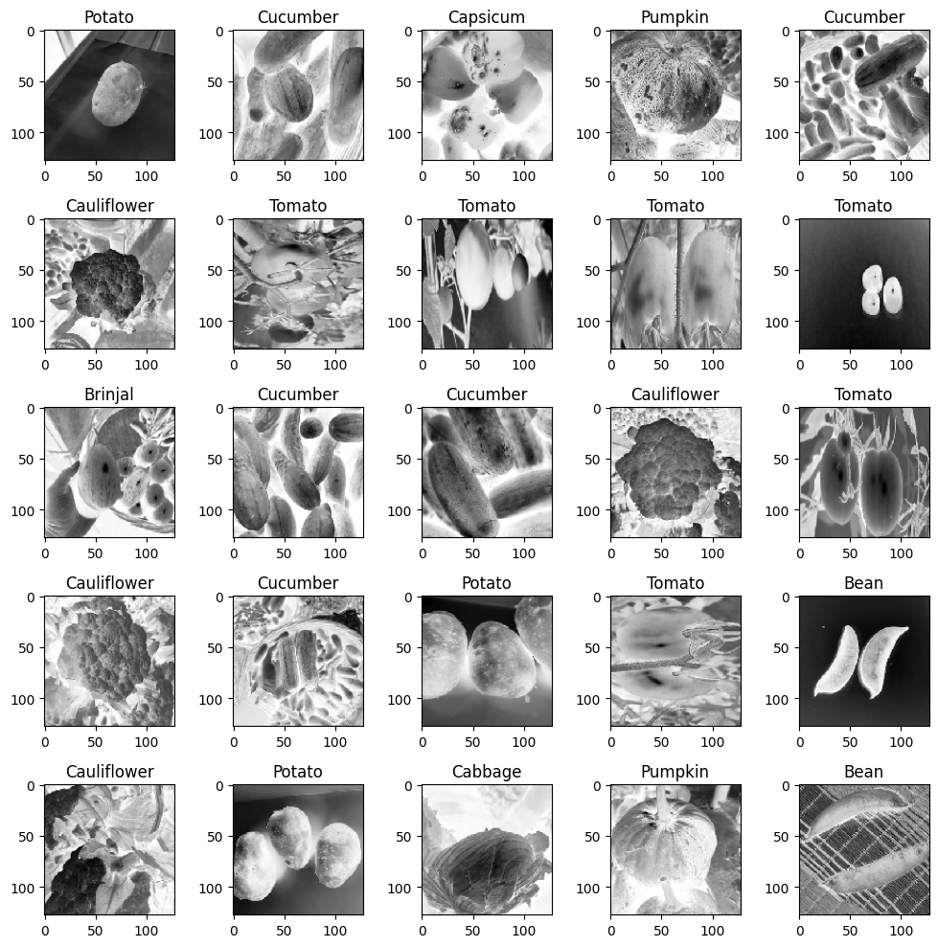
Viewing Processed Image Data
31 x 31 px
128 x 128 px

Slide 6
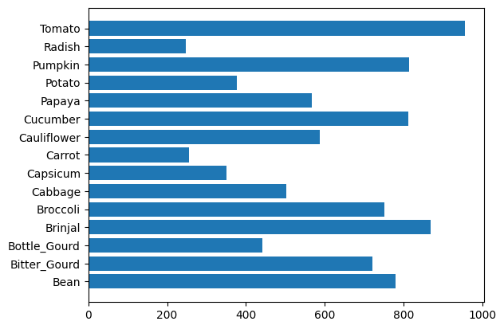
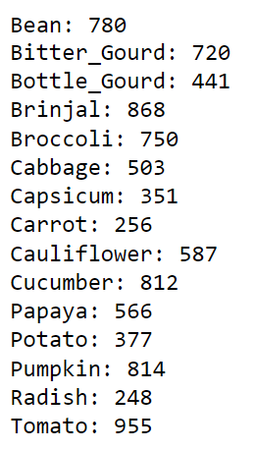
Understanding the Data Distribution
The data shows that the distribution of the classes is IMBALANCED.
So, we will explore class resampling to balance the image classes to prevent biased results.
Based on this result, we see that TOMATO had the most number of images at 955, while RADISH had the least number of images at 248.

Slide 7
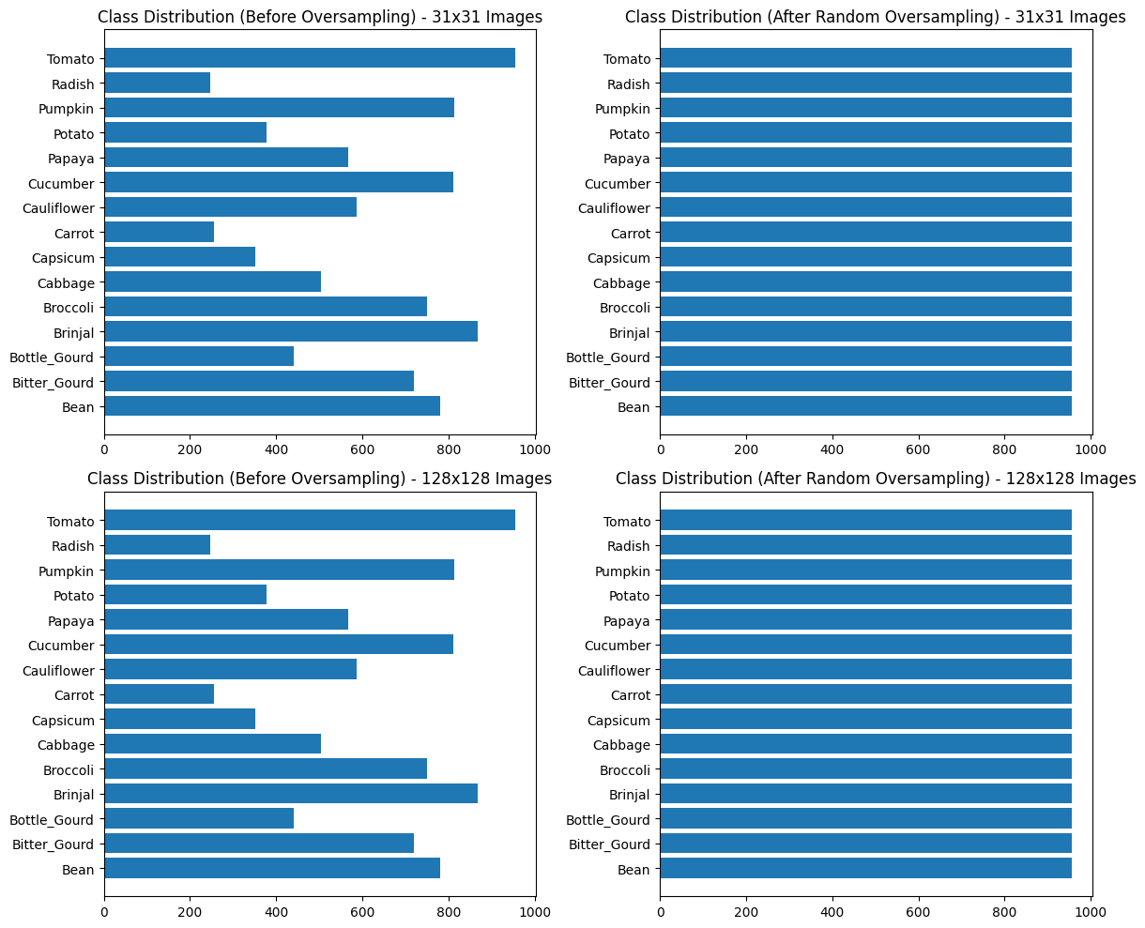
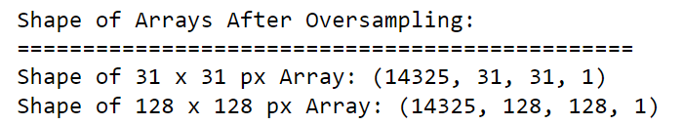
Feature Engineering
Handle Unbalanced Data : Class Oversampling using RandomOverSampler()
After oversampling, we see that the classes are now balanced with an equal number of images.
This shows there is no dominant class now and the images have a balanced representation.
Oversampling generated more images for the minority class, thus there is more data for training and evaluation now.

Slide 8
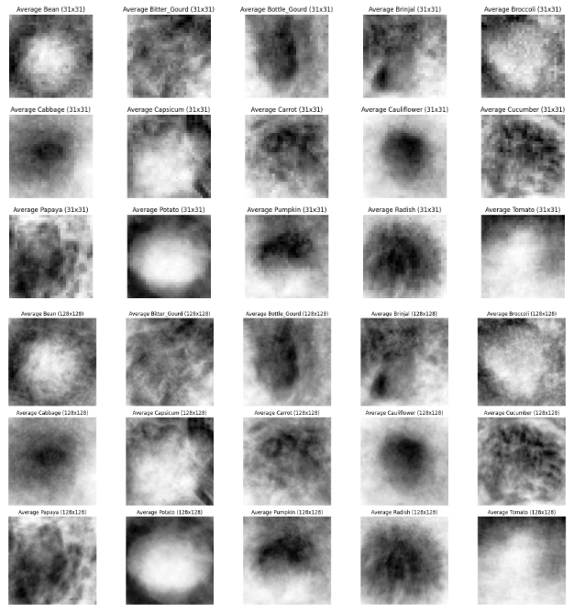
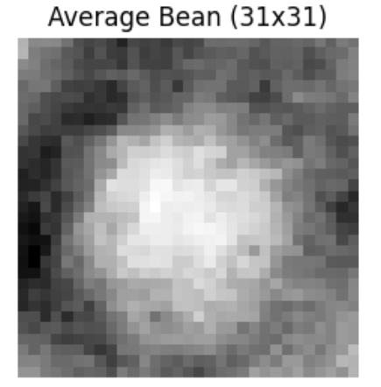
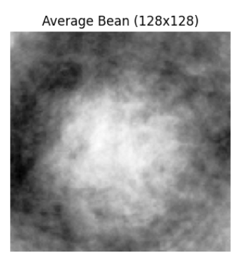
Feature Engineering
Image Averaging : Stack all images in the dataset and average each other
From image averaging, we see that it may be difficult to make out what class each image represents as the images were scaled down to 31 px and 128 px.
Pixelated 31 px images seem to capture the key features more clearly while clearer 128 px may struggle to capture more distinct features in the image.

Slide 9
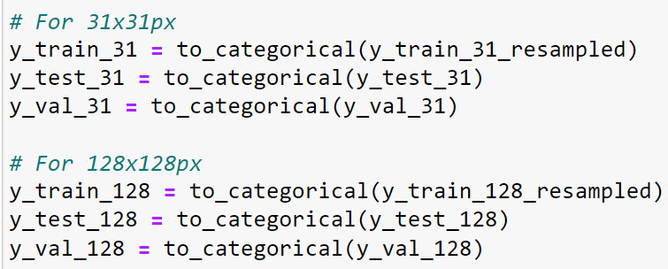
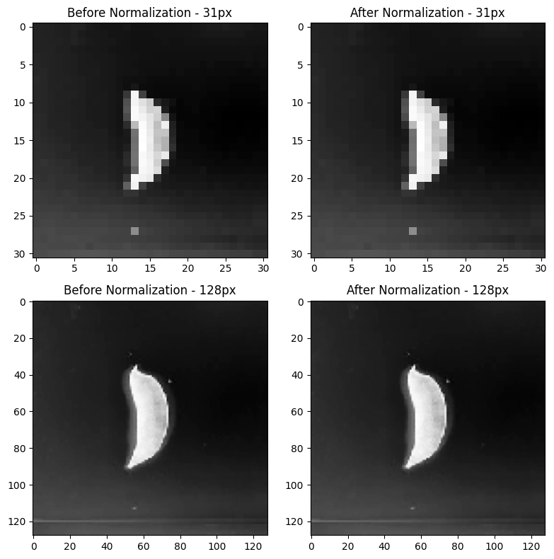
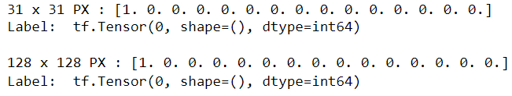
Feature Engineering
ONE-HOT ENCODING
INPUT NORMALIZATION
Using Keras `to_categorical`, one-hot encode the labels from 0-14.
Normalize the images using 1/255 to scale them to the range from 0 – 1.

Slide 10
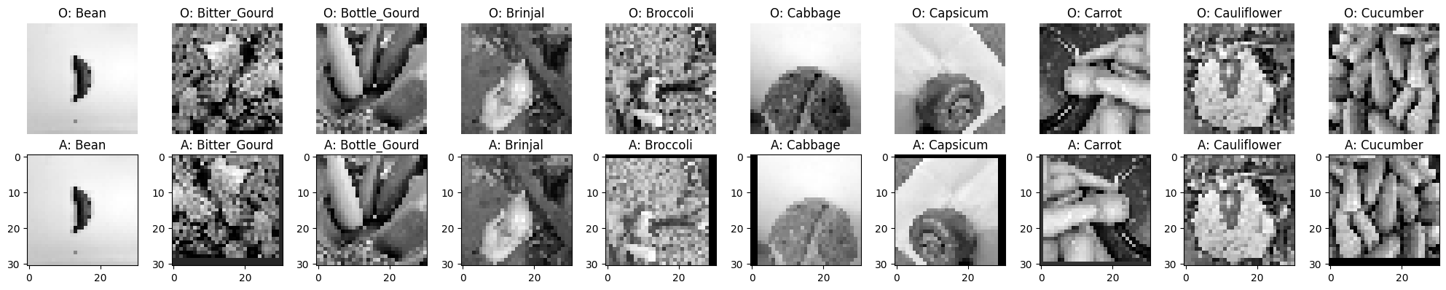
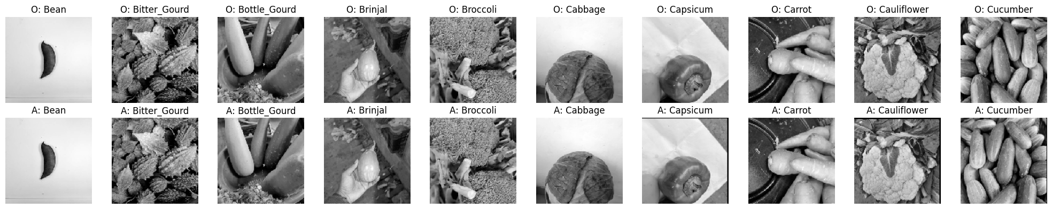
Data Augmentation – Training Set
To help in reducing overfitting and increasing variability in images, we apply data augmentation to the training set.
Random Brightness Variation
Random Flip
Random Crop & Padding
Random Rotation
DATA AUGMENTATION TECHNIQUES
Images varied in brightness levels, we apply random brightness for standardization.
Apply random flip & rotation as many of the images follow their own fixed rotation -> augment to create more variability for the model.
Apply random crop & padding enables the model to better generalize data and identify key features better.

Slide 11

Model Building : 31 PX x 31 PX
Optimizer : SGD – More detailed in recognizing and distinguishing image features
Augmentation : Random Brightness, Random Crop & Pad, Random Flip, Random Rotation
1
2
3
4
5
BASELINE FULLY CONNECTED MODEL
CONV2D NEURAL NETWORK MODEL
CUSTOM ALEXNET
MODEL
CUSTOMNET MODEL
(SELF-DESIGNED)
CUSTOMVGG
MODEL
Val Acc : 0.65
Val Loss : 2.71
Aug Val Acc : 0.54
Aug Val Loss : 2.65
Val Acc : 0.92
Val Loss : 0.35
Aug Val Acc : 0.91
Aug Val Loss : 0.41
Val Acc : 0.96
Val Loss : 0.16
Aug Val Acc : 0.95
Aug Val Loss : 0.20
Val Acc : 0.92
Val Loss : 0.38
Aug Val Acc : 0.89
Aug Val Loss : 0.40
Val Acc : 0.89
Val Loss : 0.38
Aug Val Acc : 0.88
Aug Val Loss : 0.42
Based on the 5 models tested for 31 x 31 px images, CustomVGG achieved the highest validation accuracy and lowest validation losses.
Non-augmented data performed better as well compared to augmented data.

Slide 12
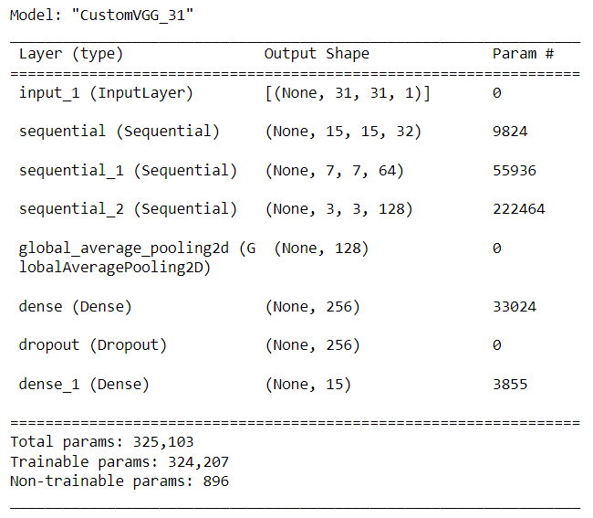
Model Building : 31 X 31 PX
For our 31 x 31 PX model :
VGGBlock 1 : Outputs 32 feature maps of 15 x 15
VGGBlock 2 : Outputs 64 feature maps of 7 x 7
VGGBlock 3 : Output 128 feature maps of 3 x 3
Global Average Pooling Layer : Reduces each feature map to a single value
Fully Connected Layers : Dense Layer, Dropout for Regularization, Output Dense Layer

Slide 13
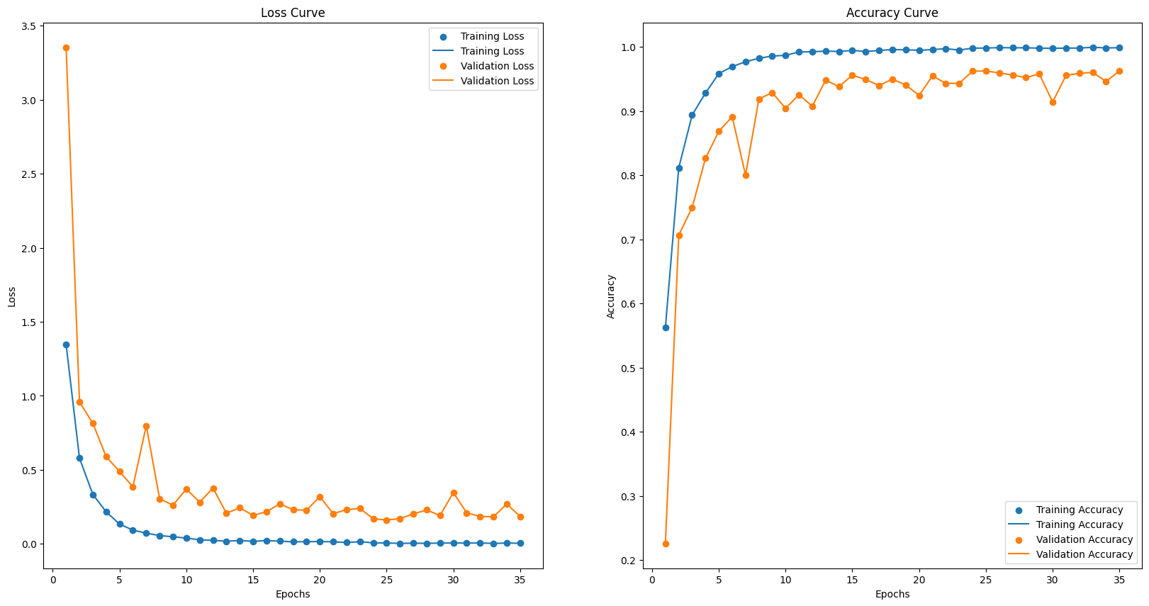
Model Building : 31 X 31 PX
SMALL OVERFIT
Train Loss : 0.005
Validation Loss : 0.16
Train Accuracy : 0.99
Validation Accuracy : 0.96
SMALL OVERFIT

Slide 14
Model Building : 128 PX X 128 PX
Optimizer : SGD – More detailed in recognizing and distinguishing image features
Augmentation : Random Brightness, Random Crop & Pad, Random Flip, Random Rotation
1
2
3
4
5
BASELINE FULLY CONNECTED MODEL
CONV2D NEURAL NETWORK MODEL
CUSTOM ALEXNET
MODEL
CUSTOMNET MODEL
(SELF-DESIGNED)
CUSTOMVGG
MODEL
Val Acc : 0.27
Val Loss : 2.42
Aug Val Acc : 0.43
Aug Val Loss : 2.36
Val Acc : 0.93
Val Loss : 0.29
Aug Val Acc : 0.95
Aug Val Loss : 0.21
Val Acc : 0.99
Val Loss : 0.02
Aug Val Acc : 0.98
Aug Val Loss : 0.04
Val Acc : 0.95
Val Loss : 0.23
Aug Val Acc : 0.95
Aug Val Loss : 0.20
Val Acc : 0.92
Val Loss : 0.47
Aug Val Acc : 0.93
Aug Val Loss : 0.37
Based on the 5 models tested for 128 x 128 px images, CustomVGG achieved the highest validation accuracy and lowest validation losses.
Non-augmented data still performed better as well compared to augmented data.

Slide 15
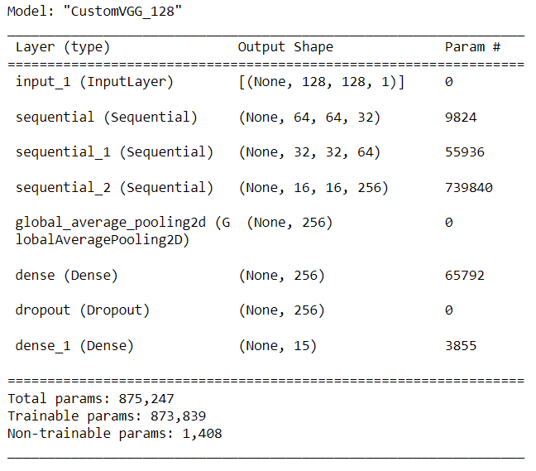
Model Building : 128 PX X 128 PX
For our 128 x 128 PX model :
VGGBlock 1 : Outputs 32 feature maps of 15 x 15
VGGBlock 2 : Outputs 64 feature maps of 7 x 7
VGGBlock 3 : Output 256 feature maps of 3 x 3
Global Average Pooling Layer : Reduces each feature map to a single value
Fully Connected Layers : Dense Layer, Dropout for Regularization, Output Dense Layer

Slide 16
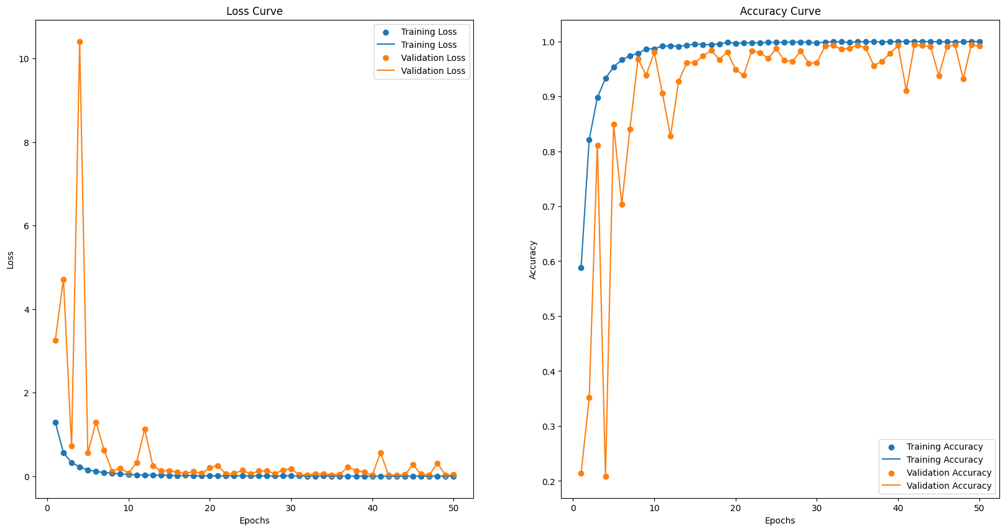
Model Building : 128 PX X 128 PX
SMALL OVERFIT (ADDRESSED IN TUNING)
Train Loss : 0.0016
Validation Loss : 0.02
Train Accuracy : 0.999
Validation Accuracy : 0.993
SMALL OVERFIT (ADDRESSED IN TUNING)

Slide 17
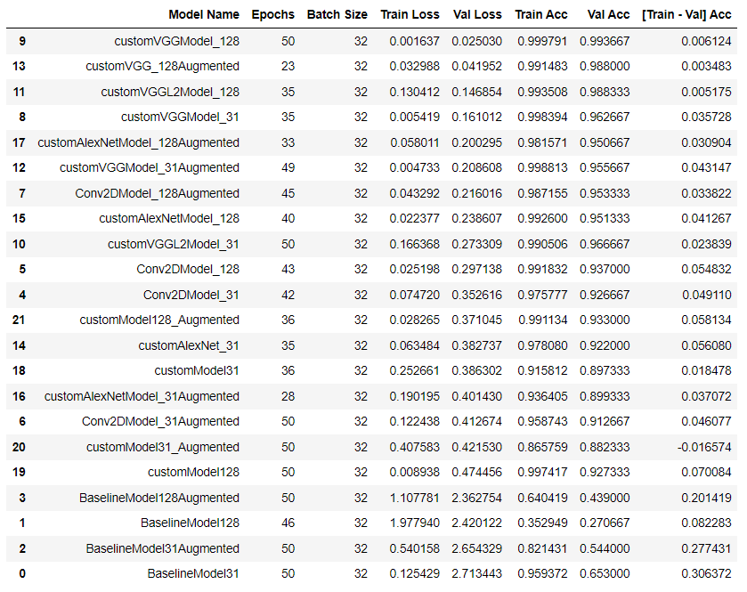
Model Evaluation & Selection
Models were tested with the following :
L2 Regularization
Early Stopping : Val Acc
Augmented Data
Oversampled Data
Best Model For 31 PX x 31 PX
customVGGModel_31
Oversampled Data
Early Stopping : Val Acc
Best Model For 128 PX x 128 PX
customVGGModel_128
Oversampled Data
Early Stopping : Val Acc

Slide 18
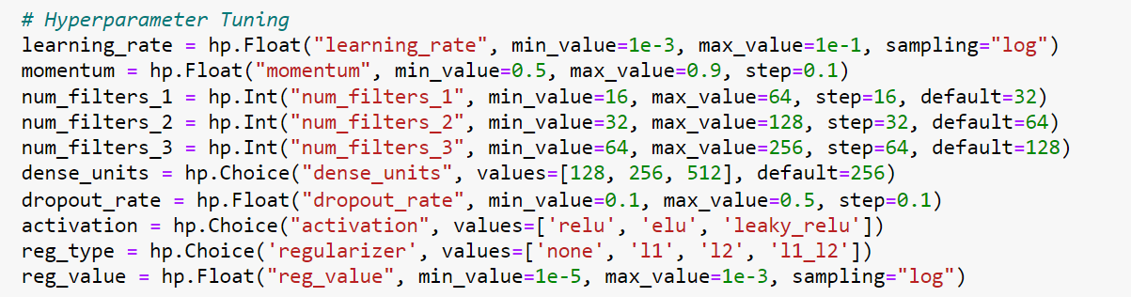
Hyperparameter Tuning of Model
For model improvement, I experimented with many parameters over 5 trials with Keras Tuner :
Learning Rate, Momentum, Activation Function
Number of Filters & Dense Units
Dropout Rate
Regularization Types : L1 & L2 & L1_L2
Learning Rate Scheduler : Cosine Annealing

Slide 19
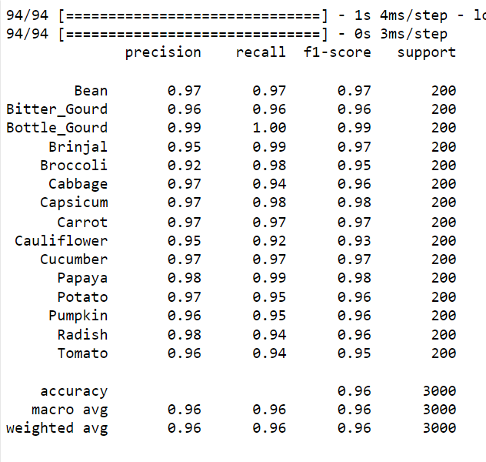
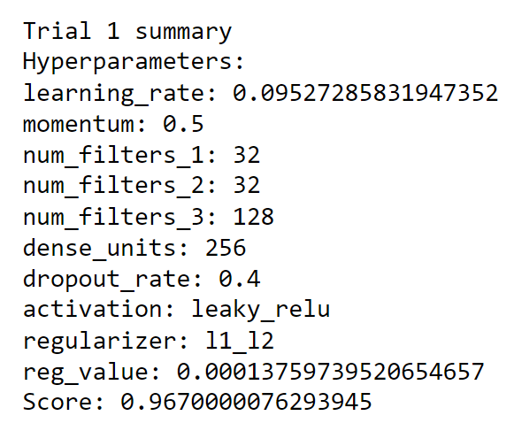
Model Evaluation : 31 PX x 31 PX
Final Validation Accuracy = 96.7% (+0.5%)
Final Test Accuracy = 96%
Bottle Gourd performed the best, with highest metrics across the board.
Broccoli and Cauliflower has slightly lower F1-scores, highlighting need for future improvements.
Best Hyperparameters :

Slide 20
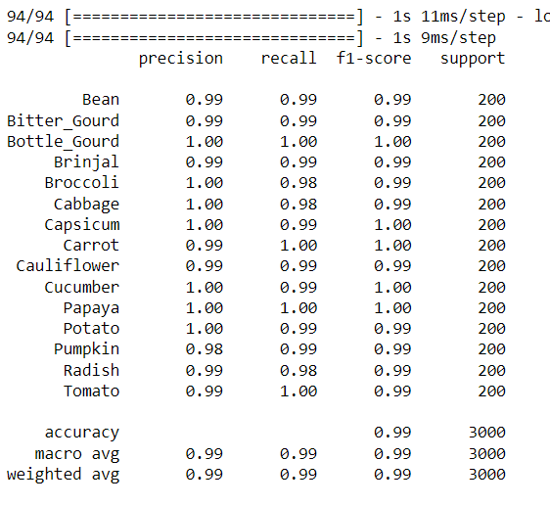
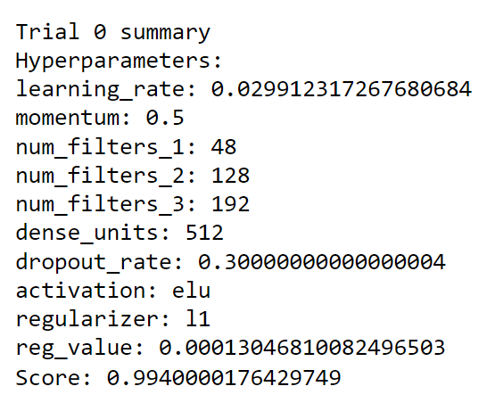
Model Evaluation : 128 PX x 128 PX
Final Validation Accuracy = 99.4% (+0.1%)
Final Test Accuracy = 99%
Bottle Gourd performed the best, with highest precision and recall scores.
Broccoli, Cabbage and Radish has slightly lower recall scores, highlighting need for future improvements.
Best Hyperparameters :

Slide 21
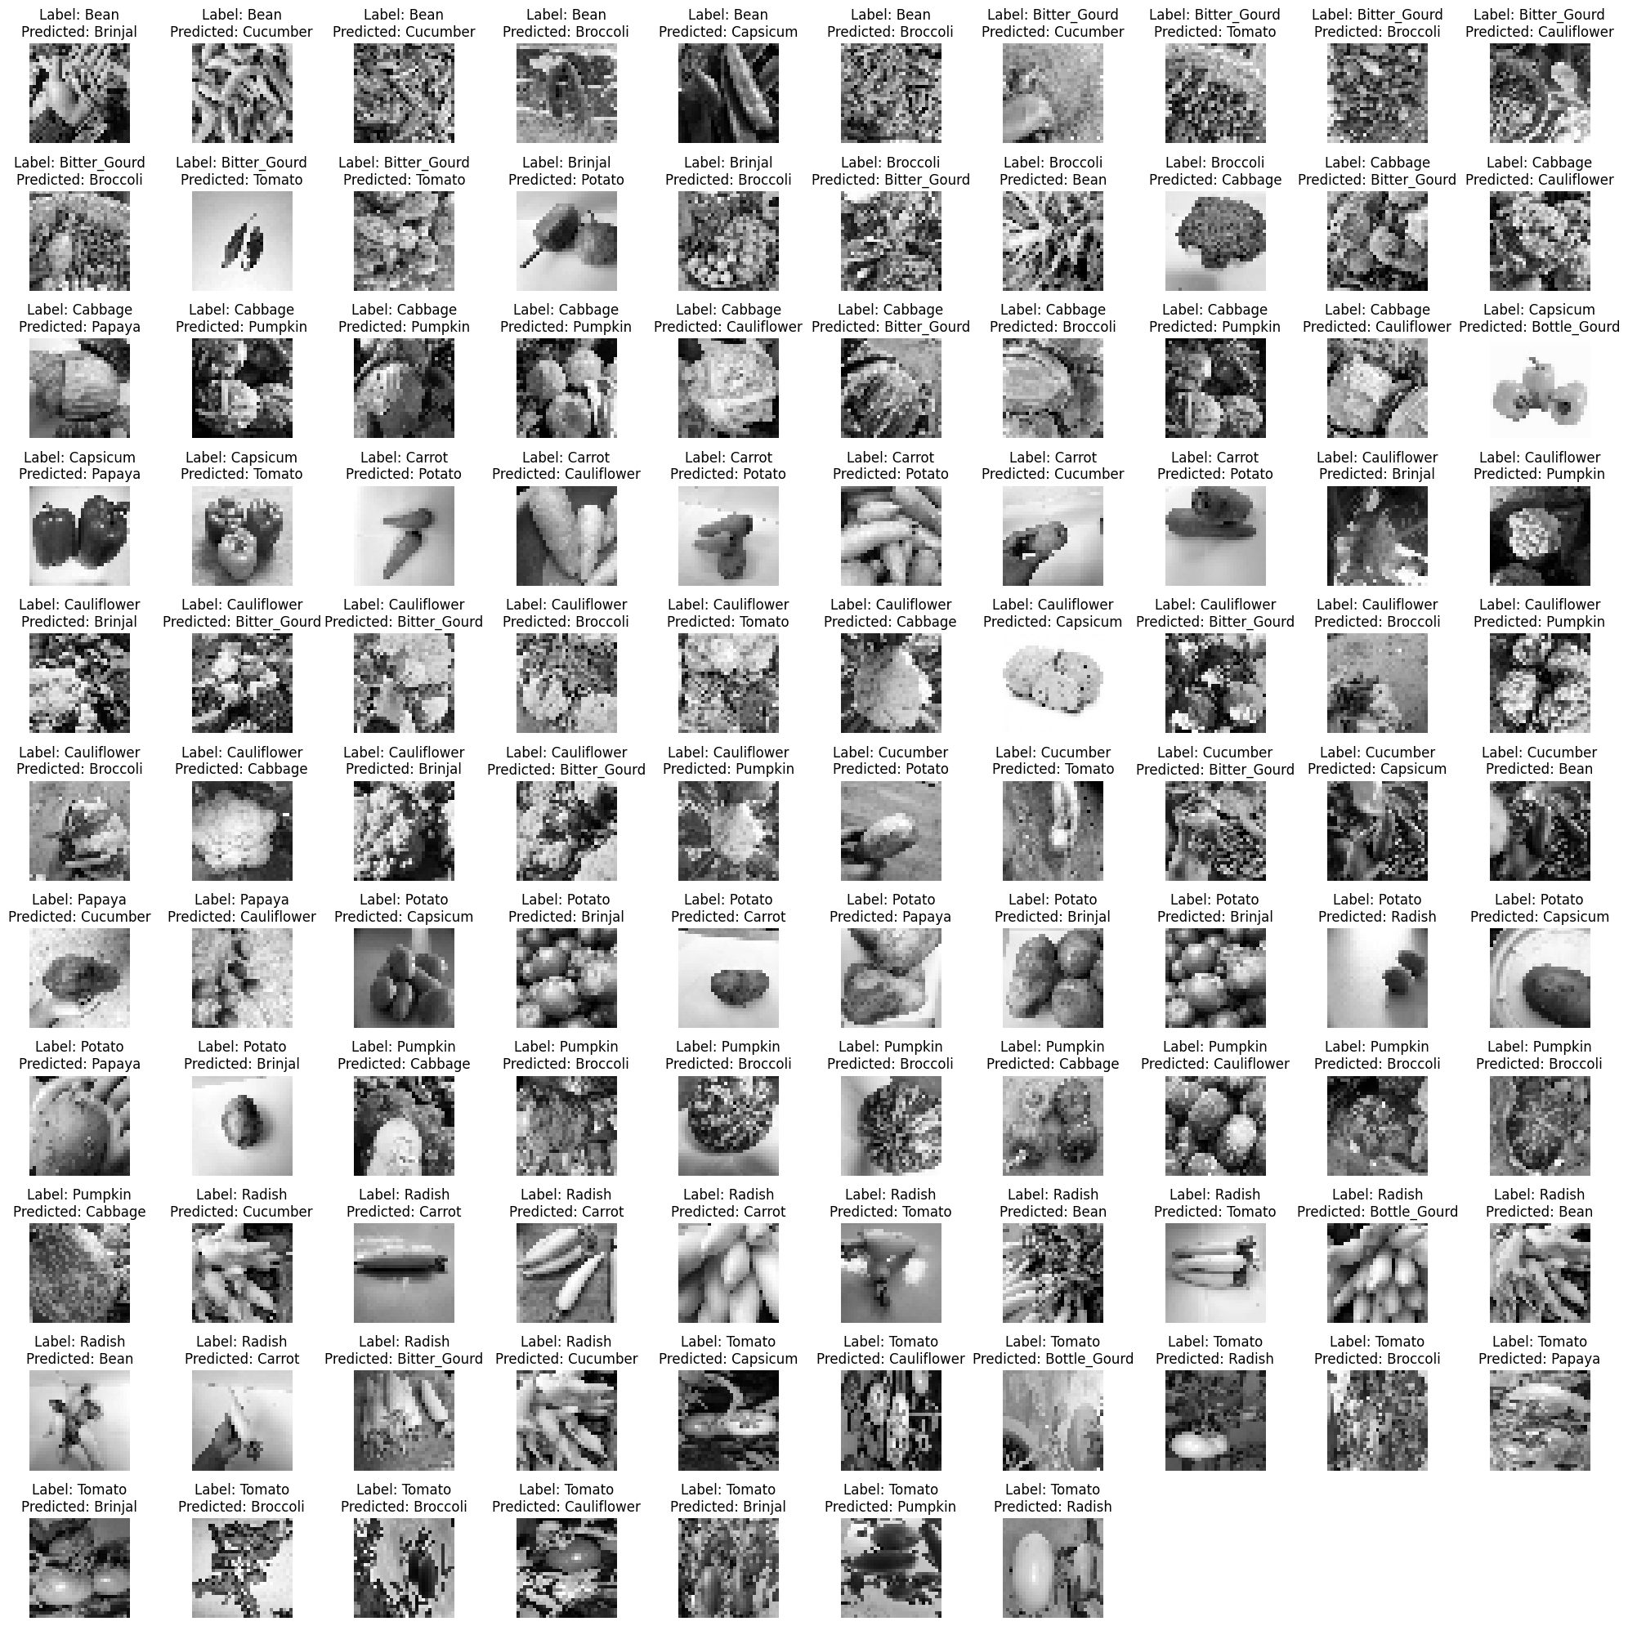
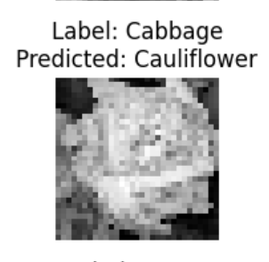
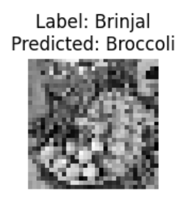
Error Analysis : 31 PX x 31 PX
Incorrect Predictions :
Given that the model achieved a high accuracy of 96%, it predicted only 3.5% (107) images incorrectly, indicating that the model generalized well to unseen data.
Looking at the misclassifications, it is understandable the model makes errors as some vegetables may look similar in shape and size, such as mistaking cabbage as cauliflower.

Slide 22
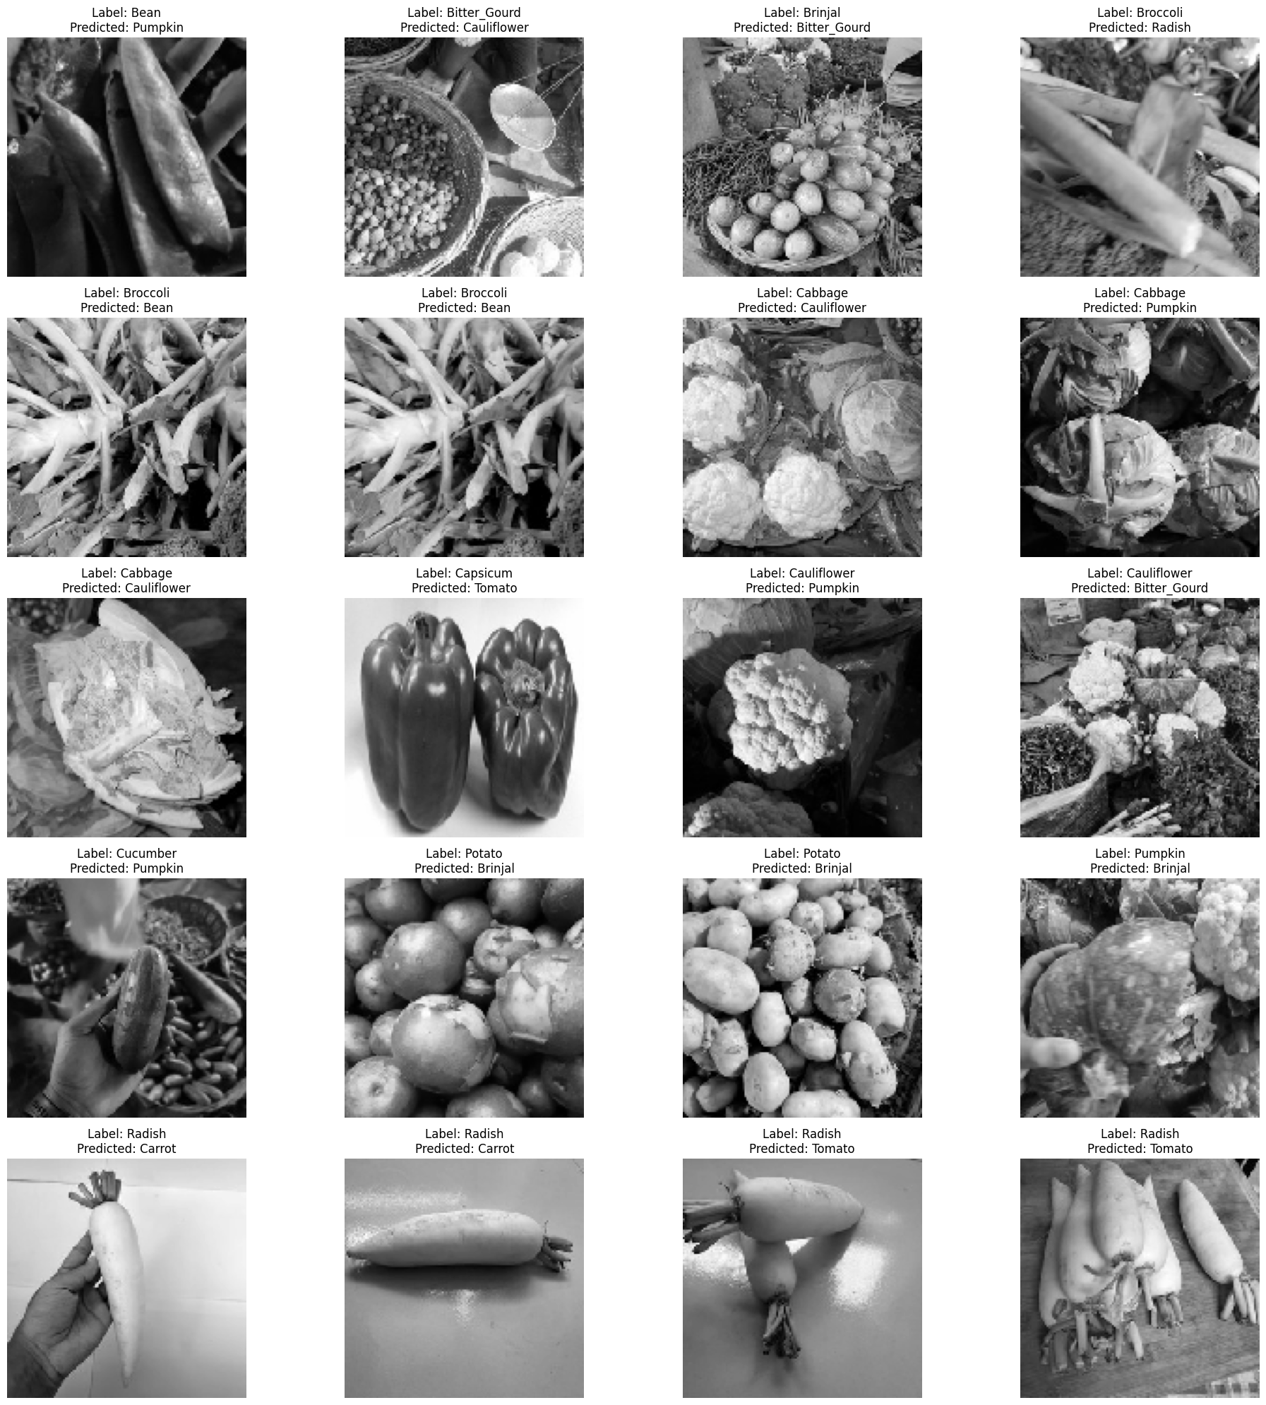
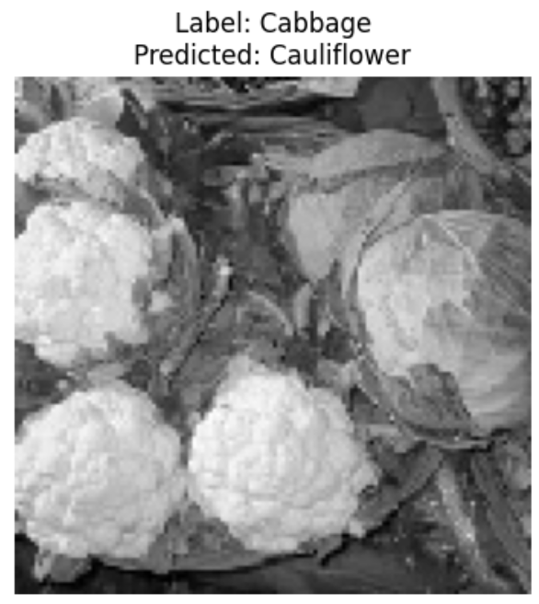
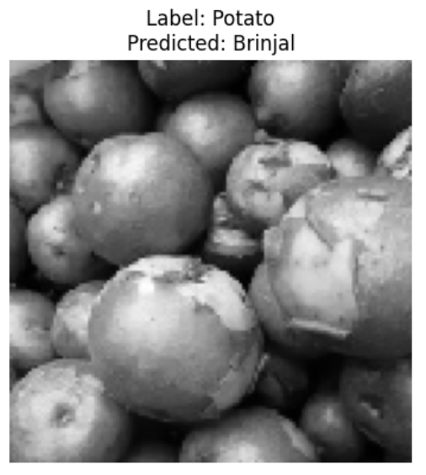
Error Analysis : 128 PX x 128 PX
Incorrect Predictions :
Given that the model achieved a high accuracy of 99%, it predicted only 0.6% (20) images incorrectly, indicating that the model generalized very well to unseen data.
It is understandable the model may make some errors as there may be other objects in the frame for a certain vegetable, for example the image of a cabbage having cauliflowers in the background.

Slide 23
Conclusion of Analysis
31 PX x 31 PX
BEST MODEL : CUSTOMVGG MODEL + OVERSAMPLED DATA + L1_L2 REGULARIZER
128 PX X 128 PX
BEST MODEL : CUSTOMVGG MODEL + OVERSAMPLED DATA + L1 REGULARIZER
HOW TO IMPROVE?
Some methods to further enhance the model’s performance can include using ensemble techniques and using other callbacks like ReduceLROnPlateau to make training faster and further improve the accuracy achieved, especially for 31 PX x 31 PX images.
WAS AUGMENTATION HELPFUL?
Augmented Data was more useful for 128 PX x 128 PX images as it was a higher-resolution image with less pixelated features, but when applied to 31 PX x 31 PX images, it may have introduced irrelevant noise in the data, making it difficult for the model to generalize well to the low-resolution features.

Slide 24
Thank You!
Any Questions?

